Slide 1
PROCESS-TO-PROCESS DELIVERY
The transport layer is responsible for process-to-process delivery—the delivery of a packet, part of a message, from one process to another. Two processes communicate in a client/server relationship, as we will see later.

Slide 2

Note
The transport layer is responsible for process-to-process delivery.

Slide 3

Figure 23.1 Types of data deliveries

Slide 4
Client, server
1. Local host
2. Local process
3. Remote host
4. Remote process

Slide 5
lANA Ranges
The lANA (Internet Assigned Number Authority) has divided the port numbers into
three ranges: well known, registered, and dynamic (or private)
o Well-known ports.
The ports ranging from 0 to 1023 are assigned and controlled
by lANA. These are the well-known ports.
Registered ports. The ports ranging from 1024 to 49,151 are not assigned or controlled
by lANA.
Dynamic ports. The ports ranging from 49,152 to 65,535 are neither controlled
nor registered. They can be used by any process. These are the ephemeral ports

Slide 6

Figure 23.2 Port numbers

Slide 7

Figure 23.3 IP addresses versus port numbers

Slide 8

Figure 23.4 IANA ranges

Slide 9

Figure 23.5 Socket address

Slide 10

Figure 23.6 Multiplexing and demultiplexing

Slide 11
Connectionless Versus Connection-Oriented Service
Connectionless Service
In a connectionless service, the packets are sent from one party to another with no need for connection establishment or connection release. The packets are not numbered; they may be delayed or lost or may arrive out of sequence. There is no acknowledgment either. We will see shortly that one of the transport layer protocols in the Internet model, UDP, is connectionless.
Connection-Oriented Service
In a connection-oriented service, a connection is first established between the sender and the receiver. Data are transferred. At the end, the connection is released. TCP and SCTP are connection-oriented protocols.

Slide 12
Reliable Versus Unreliable
The transport layer service can be reliable or unreliable. If the application layer program needs reliability, we use a reliable transport layer protocol by implementing flow and error control at the transport layer. This means a slower and more complex service.
On the other hand, if the application program does not need reliability because it uses its own flow and error control mechanism or it needs fast service or the nature of the service does not demand flow and error control (real-time applications), then an unreliable protocol can be used.
UDP is connectionless and unreliable; TCP and SCTP are connection oriented and reliable.
These three can respond to the demands of the application layer programs.

Slide 13

Figure 23.7 Error control

Slide 14

Figure 23.8 Position of UDP, TCP, and SCTP in TCP/IP suite

Slide 15
USER DATAGRAM PROTOCOL (UDP)
The User Datagram Protocol (UDP) is called a connectionless, unreliable transport protocol. It does not add anything to the services of IP except to provide process-to-process communication instead of host-to-host communication.

Slide 16

Figure 23.9 User datagram format

Slide 17
Note
UDP length
= IP length – IP header’s length

Slide 18

Figure 23.10 Pseudoheader for checksum calculation

Slide 19
Example 23.2
Figure 23.11 shows the checksum calculation for a very small user datagram with only 7 bytes of data. Because the number of bytes of data is odd, padding is added for checksum calculation. The pseudoheader as well as the padding will be dropped when the user datagram is delivered to IP.

Slide 20

Figure 23.11 Checksum calculation of a simple UDP user datagram

Slide 21
UDP Operation
Connectionless service- no relation between datagram, not numbered
No Flow and error control- no flow control so no window mechanics.
No error control except checksum (silently discard packet)
Encapsulation and decapsulation – IP Datagrams

Slide 22
Example 23.2.3
A UDP header in hexadecimal format
06 32 00 0D 00 1C E2 17
What is the source port number?
What is the destination port number?
What is the total length of the user datagram?
What is the length of the data?

Slide 23
Queuing
Incoming and outgoing queue
It will obtain only one port number
Port unreachable icmp message (if queue is not created)

Slide 24

Figure 23.12 Queues in UDP

Slide 25
Uses of UDP
Suitable for process that require simple request response communication with little concern for flow and error control.
Suitable for multicasting
Used for management process such as SNMP
Used for routing updating protocol : RIP

Slide 26
23-3 TCP
TCP is a connection-oriented protocol; it creates a virtual connection between two TCPs to send data. In addition, TCP uses flow and error control mechanisms at the transport level.
Topics discussed in this section:
TCP Services
TCP Features
Segment
A TCP Connection
Flow Control
Error Control

Slide 27

Figure 23.13 Stream delivery

Slide 28

Figure 23.14 Sending and receiving buffers

Slide 29

Figure 23.15 TCP segments

Slide 30
TCP
Connection oriented phase-
Reliable
Features
  Numbering system
    No segment number – use byte number – sequence number, ack number
    0- 2^32 -1
Flow control
Error control
Congestion control

Slide 31
Note
The bytes of data being transferred in each connection are numbered by TCP.
The numbering starts with a randomly generated number.

Slide 32

Example 23.3
The following shows the sequence number for each segment:

Slide 33
Note
The value in the sequence number field of a segment defines the
number of the first data byte
contained in that segment.

Slide 34
Note
The value of the acknowledgment field in a segment defines
the number of the next byte a party expects to receive.
The acknowledgment number is cumulative.

Slide 35

Figure 23.16 TCP segment format

Slide 36

Figure 23.17 Control field

Slide 37

Table 23.3 Description of flags in the control field

Slide 38
Example 23.2.4
The following is a dump of a TCP header in hexadecimal format
05320017 00000001 00000000 500207FF 00000000
What is the source port number?
What is the destination port number?
What is sequence number?
What is the acknowledgment number?
What is the length of the header?
What is the type of the segment?
What is the window size?

Slide 39
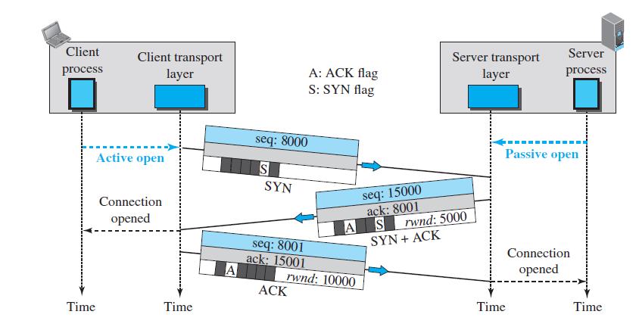
Figure 23.18 Connection establishment using three-way handshaking

Slide 40
Note
A SYN segment cannot carry data, but it consumes one sequence number.

Slide 41
Note
A SYN + ACK segment cannot
carry data, but does consume one
sequence number.

Slide 42
Note
An ACK segment, if carrying no data, consumes no sequence number.

Slide 43
Syn flooding attack
Simultaneous open

Slide 44
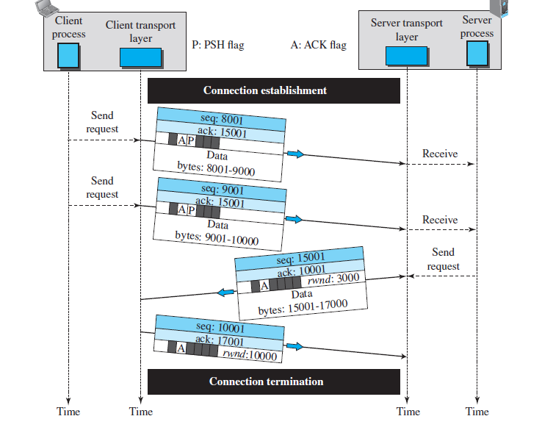
Figure 23.19 Data transfer

Slide 45
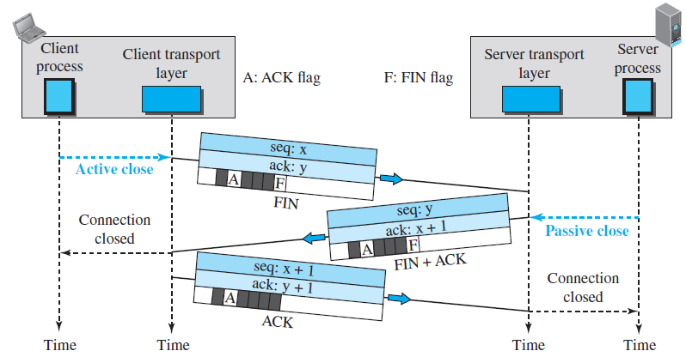
Figure 23.20 Connection termination using three-way handshaking

Slide 46
Note
The FIN segment consumes one sequence number if it does
not carry data.

Slide 47
Note
The FIN + ACK segment consumes
one sequence number if it
does not carry data.

Slide 48
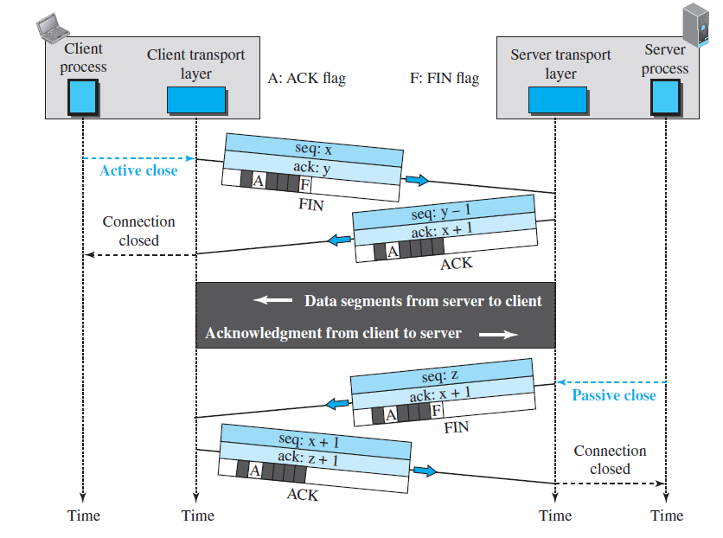
Figure 23.21 Half-close

